Slide 1
Food Loss and
Food Waste
Presented by:
Addison Brown, Ivan Aguirre
and Jessica Jordan

Slide 2

Welcome
to our final project:
Our objective was to implement data analysis using tableau, python, and machine learning to showcase our data and to ultimately show why this is an issue that must be discussed more often.

Slide 3
What is Food Waste?

Slide 4
“
“Food waste refers to the decrease in the quantity or quality of food resulting from decisions and actions by retailers, food service providers and consumers.”

Slide 5
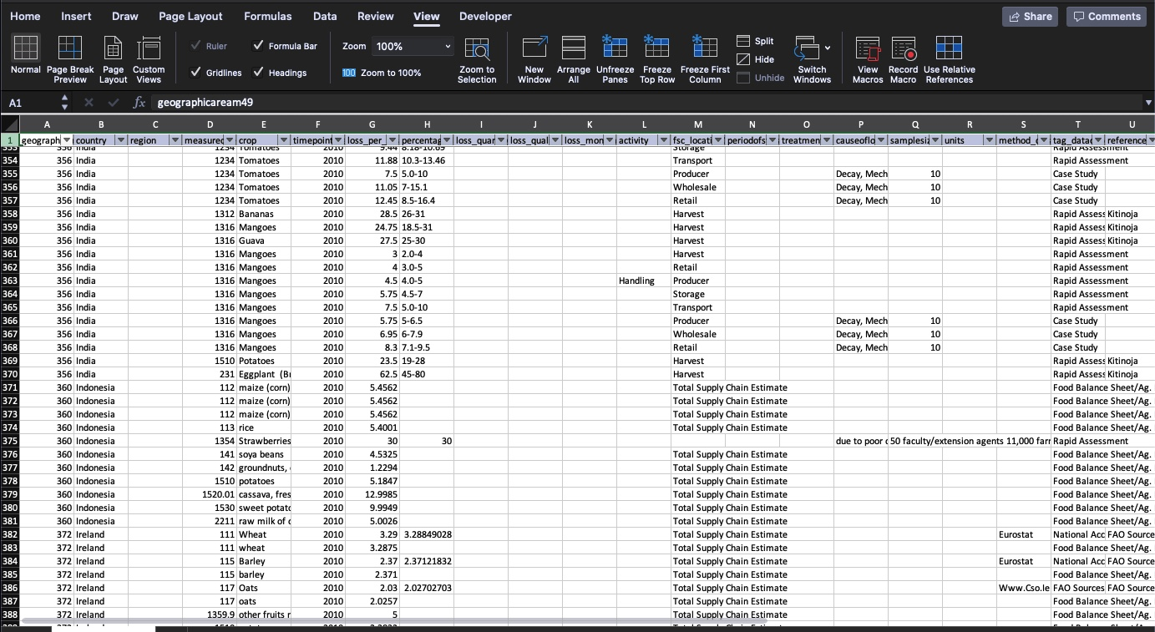
Searching for Data
We used multiple sites to search for data that provided information internationally. The Food and Agriculture Organization of the United Nations provided a Database that gave us over 16,000 rows of data.

Slide 6

But what we found was…
You can’t discuss food waste without including food loss.

Slide 7
What is Food Loss?

Slide 8
“
“Food loss is the decrease in the quantity or quality of food resulting from decisions and actions by food suppliers in the chain, excluding retailers, food service providers and consumers.”

Slide 9
Here’s some background:
Each year, an estimated one-third of all food produced for human consumption is lost or wasted world-wide. It is imperative that something is done to address the social, economic and environmental impacts of food loss and waste.

Slide 10
So does location matter?
Europe
USA
Africa
Brasil
Asia

Slide 11
https://foodloss.herokuapp.com/index.html

Slide 12
Thanks!
Questions
??

